Slide 1
you’ll get your written quiz papers today

Slide 2
MST

Slide 3
a tree again?
undirected
connected
acyclic

Slide 4
n nodes n-1 edges
exactly one path
between any two nodes

Slide 5
Minimum Spanning Tree
the tree with the least weight that spans all nodes

Slide 6
If e is a least weight edge crossing the cut, e is in the MST Max edge in a cycle is not in MST
so how do we find the MST?

Slide 7
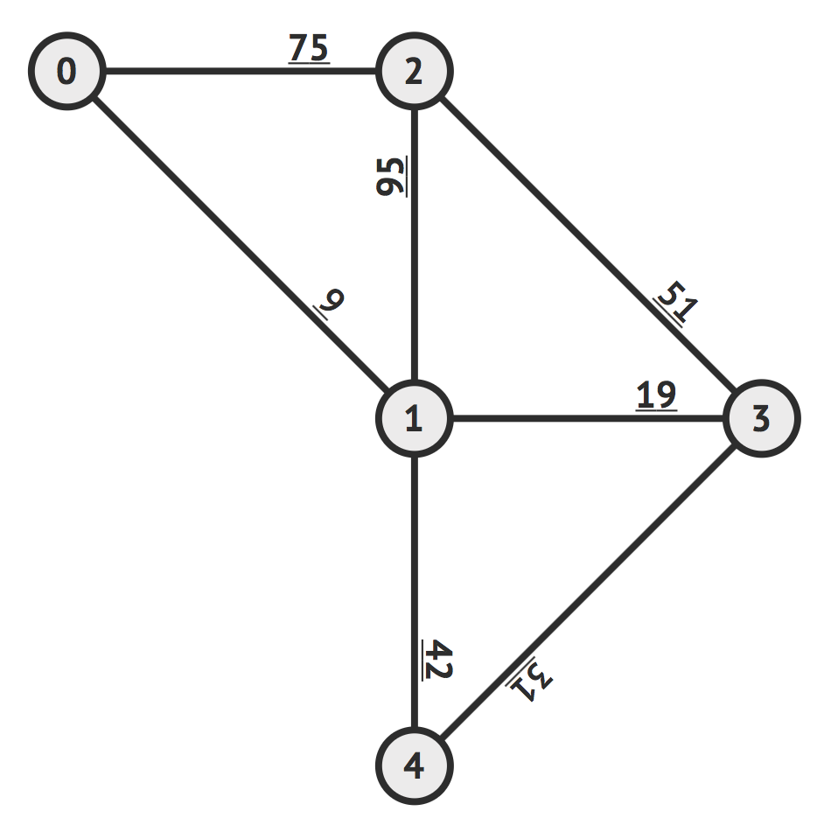
Proof

Slide 8
Prim’s
It’s almost exactly like Dijkstra's Algorithm

Slide 9
Prim’s
P for Priority Queue

Slide 10
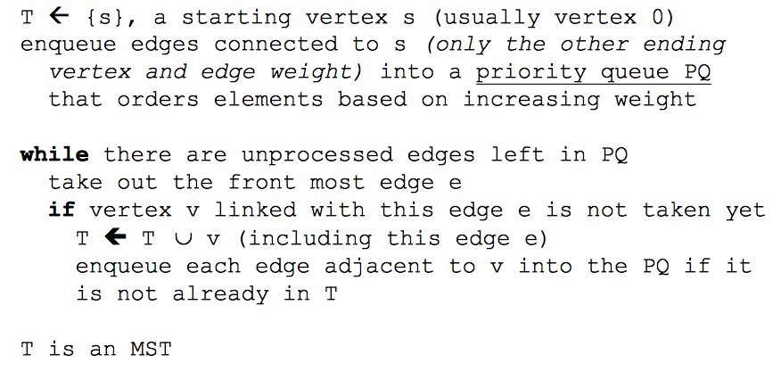
Prim’s

Slide 11
Prim’s
Every edge is enqueued once
Cost of enqueuing in a PQ: log(E)
Number of times enqueued: E times
So, O(ElogE) = O(ElogV²)
= O(E*2logV) = O(ElogV)

Slide 12
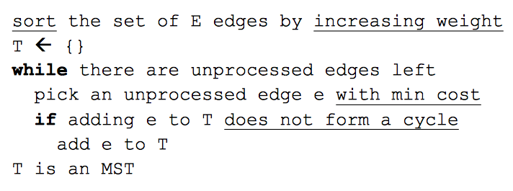
Kruskal’s

Slide 13
Kruskal’s
mstEdges = {}
edges = graph.edges
for v in graph.nodes:
Make-Set(v)
sort(edges)
for e in edges:
if findSet(e.node1) != findSet(e.node2):
mstEdges.add(e)
return mstEdges

Slide 14
Kruskal’s
mstEdges = {}
edges = graph.edges
for v in graph.nodes:
Make-Set(v)
sort(edges)
for e in edges:
if findSet(e.node1) != findSet(e.node2):
unionSet(node1, node2)
mstEdges.add(e)
return mstEdges
E(logE)
E

Slide 15
on to the tutorial

Slide 16
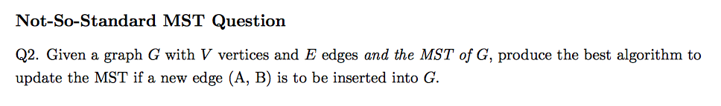

Slide 17
dfs + tree property

Slide 18
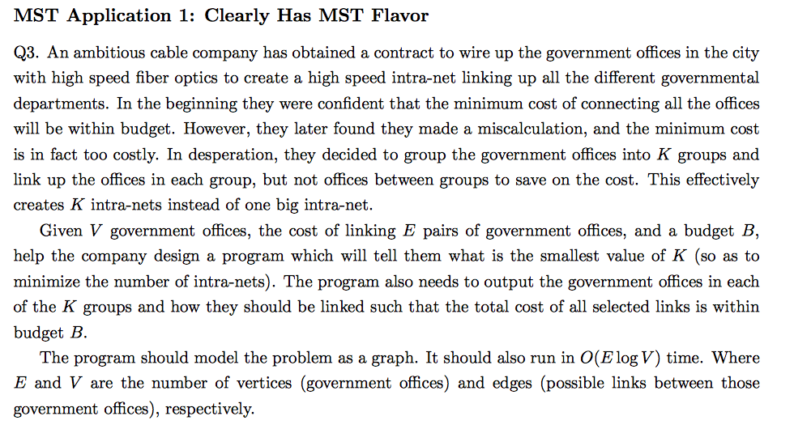

Slide 19
kruskal’s + early termination

Slide 20
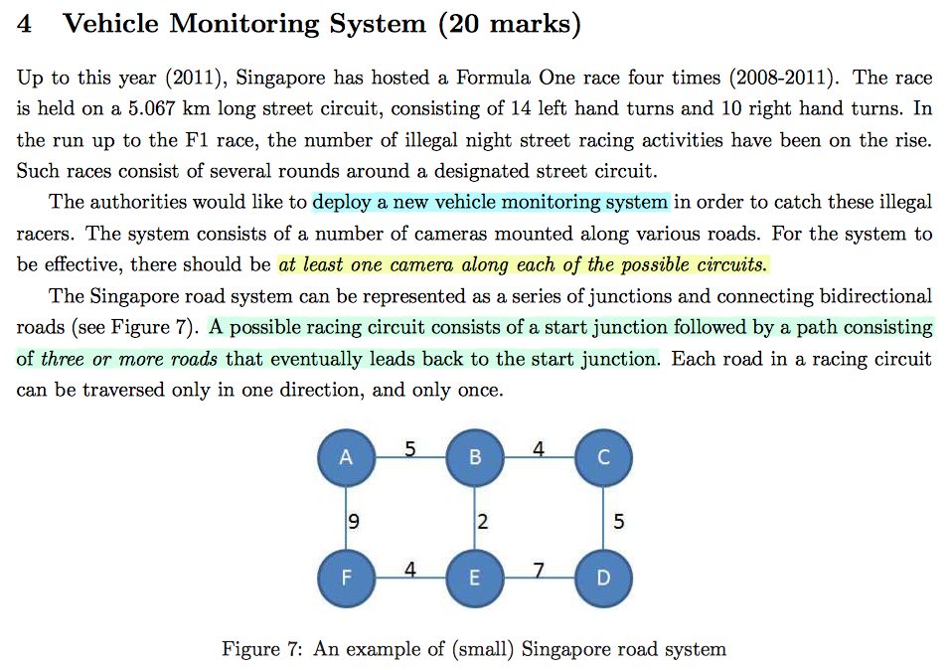

Slide 21
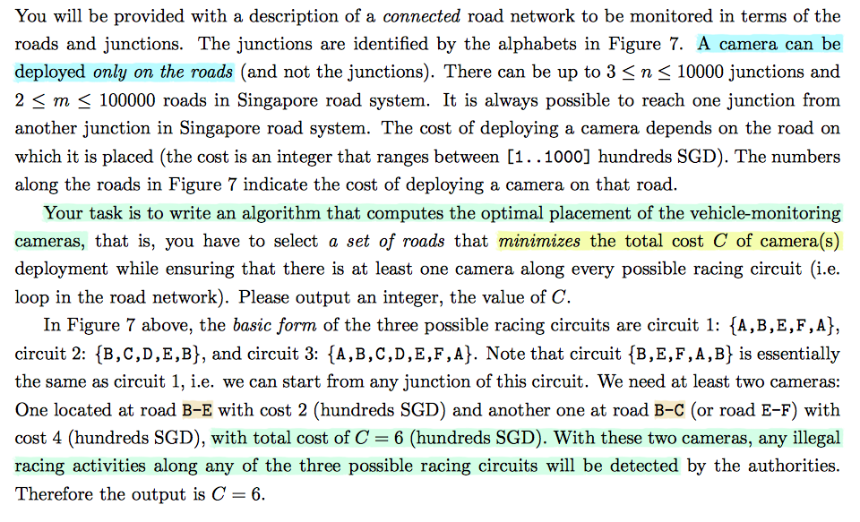

Slide 22
edges not in MaxST

Slide 23
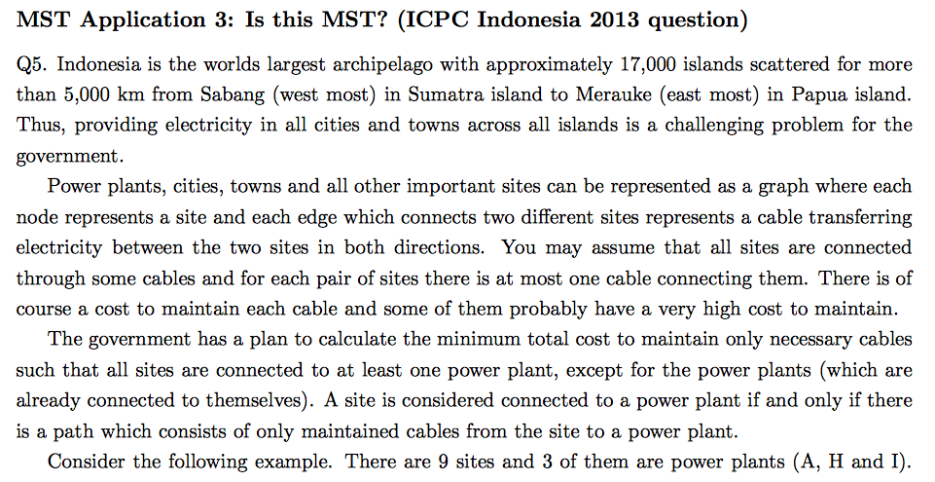

Slide 24
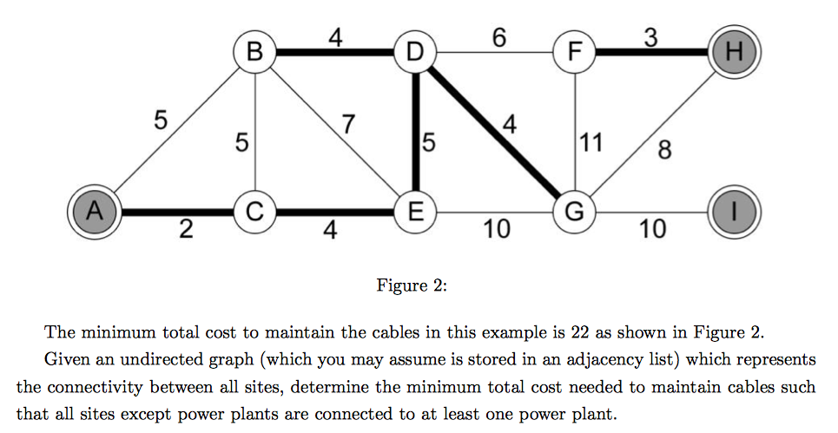

Slide 25
super(multi)-source MST

Slide 26
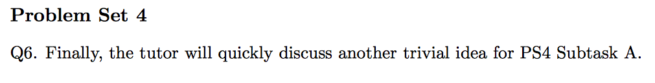

Slide 27
BYE

